Slide 1

Flight Price Prediction Project
Khushboo khatri

Slide 2
Introduction
Anyone who has booked a flight ticket knows how unexpectedly the prices vary. The cheapest available ticket on a given flight gets more and less expensive over time. This usually happens as an attempt to maximize revenue based on –
1. Time of purchase patterns (making sure last-minute purchases are expensive)
2. Keeping the flight as full as they want it (raising prices on a flight which is filling up in order to reduce sales and hold back inventory for those expensive last-minute expensive purchases).
So, you have to work on a project where you collect data of flight fares with other features and work to make a model to predict fares of flights.
Data Collection.
Model Building
Data Analysis

Slide 3
Data Collection
For Flight price prediction project, we first required to collect the data from yatra.com, skyscanner.com, official websites etc. Here we choose yatra.com as the website from where we collect the data.
For data collection we use Selenium in python, and with the help of it we scrape all the required information from the pages.
In Totality we scrape around 9 information (columns) of 2787 data(rows).
With this dataset, we start our Machine learning Model building phase.

Slide 4
Data Analysis
Data Analysis is the part of Model Building. After cleaning the data, you have to do some analysis on the data. Like asking questions: Do airfares change frequently? Do they move in small increments or in large jumps? Do they tend to go up or down over time? What is the best time to buy so that the consumer can save the most by taking the least risk? Does price increase as we get near to departure date? Is Indigo cheaper than Jet Airways? Are morning flights expensive?
Something like that, which helps us to see clear picture of the data.

Slide 5
Model Building
After collecting the data, you need to build a machine learning model. Before model building do all data pre-processing steps. Try different models with different hyper parameters and select the best model.
Follow the complete life cycle of data science. Include all the steps like
1. Data Cleaning
2. Exploratory Data Analysis
3. Data Pre-processing
4. Model Building
5. Model Evaluation
6. Selecting the best model

Slide 6
Data Cleaning
Data cleaning is the process of preparing data for analysis by removing or modifying data that is incorrect, incomplete, irrelevant, duplicated, or improperly formatted.
Feature Engineering / Feature extraction is also a part of data cleaning.
As we get our raw data, we tried to clean it, Did some feature engineering in order to make them suitable for machine learning model.
Also we drop unwanted columns, as they are of no use in the ML model building.

Slide 7
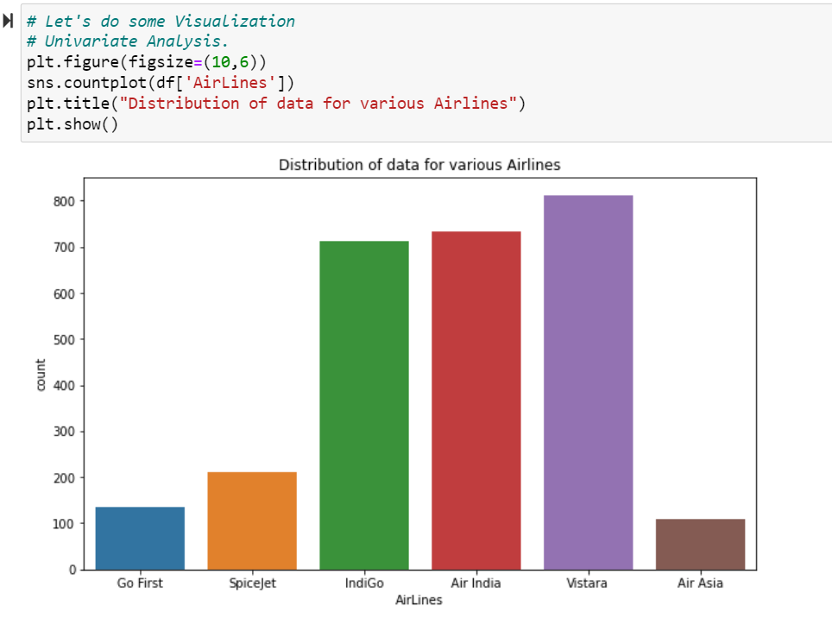
Exploratory Data Analysis
It is visual analysis of data, which helps us to get clear understanding about our dataset. We did both Univariate analysis and Multivariate analysis.
Let’s starts with Univariate analysis:
We basically plot count plot for categorical
Data, while for numerical data we plot
Distplot, which gives us complete idea about
Data distribution.

Slide 8
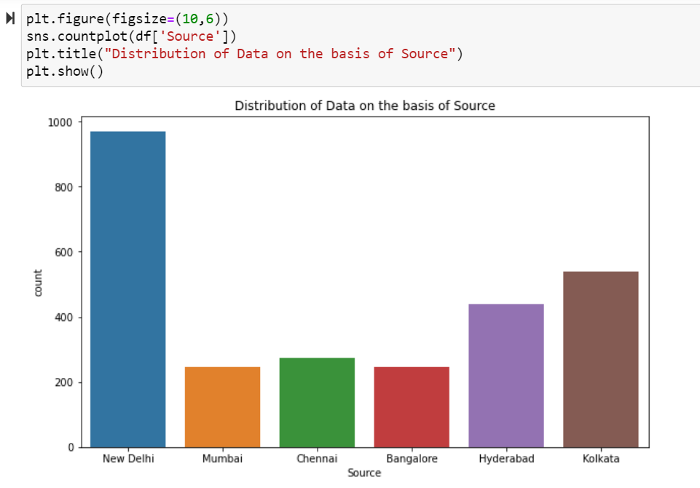
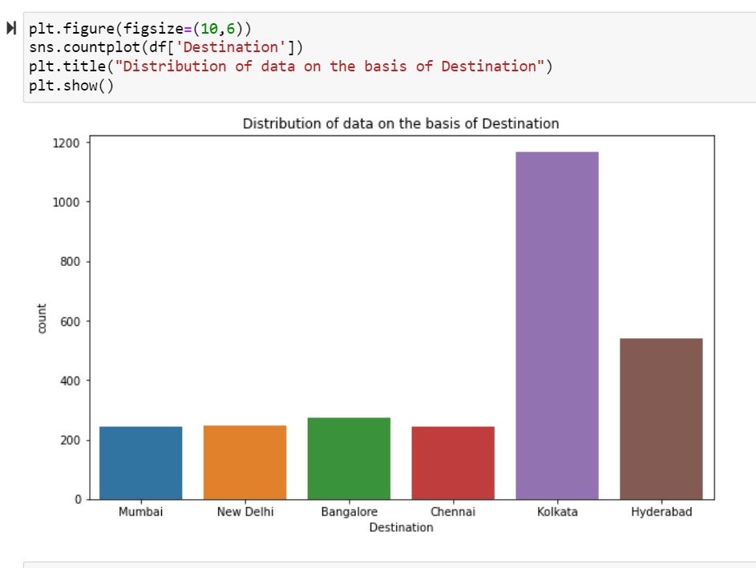
From above observation New Delhi has highest count as Source. While for Destination Kolkata seems to have highest count.

Slide 9
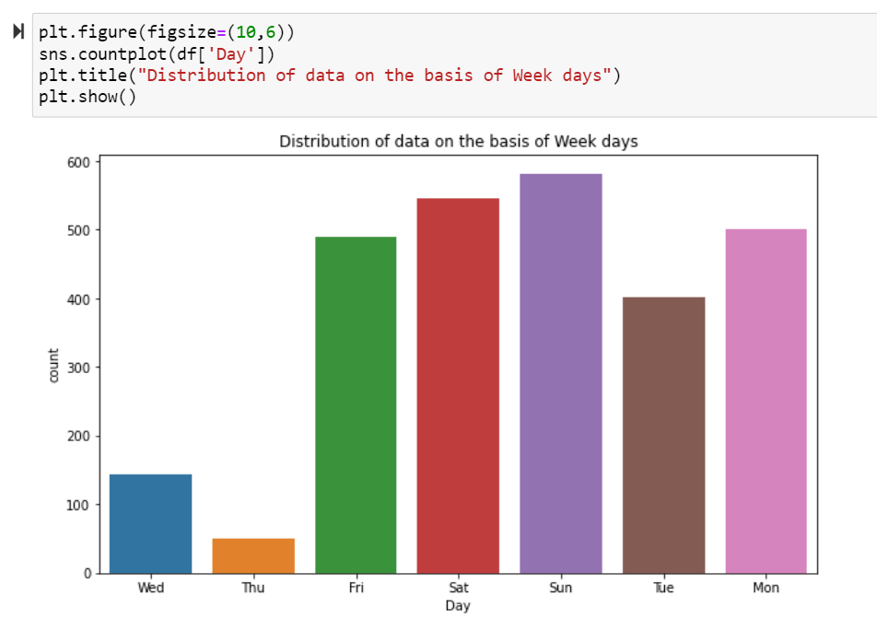
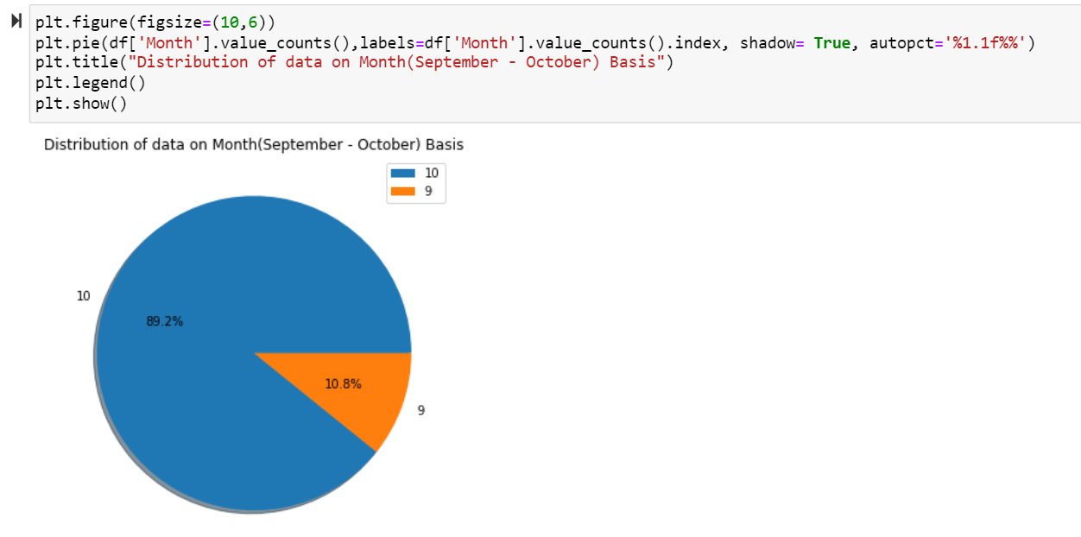
We can see the distribution of data on the basis of week days. Sunday registered highest data.
As we can also observe that we have data for only two months, out of which October month has more data comparatively to September month.

Slide 10
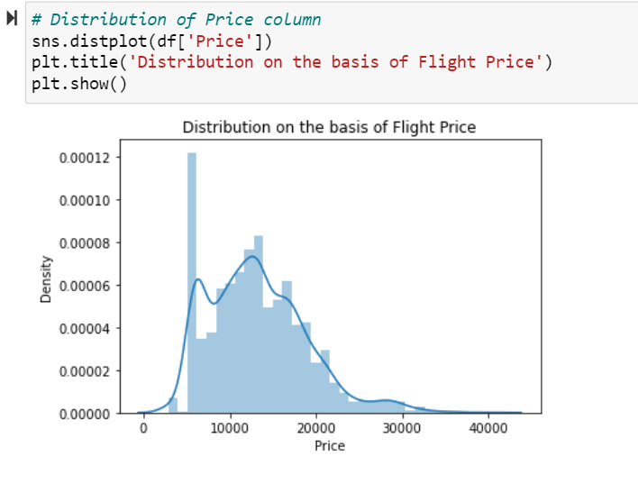
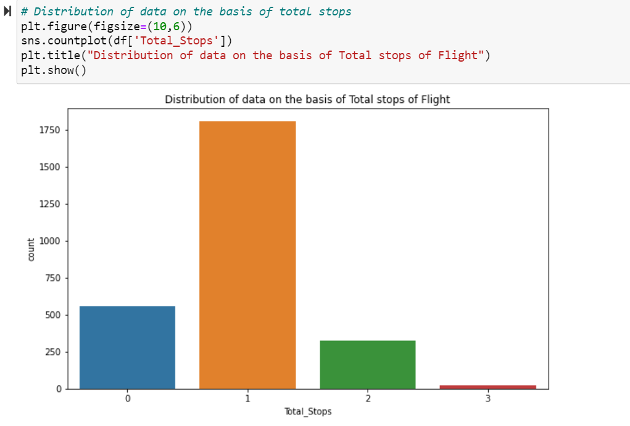
We can observe that the Price of Flight Ticket varies from somewhere 5000 to 30000. For our dataset, most of the flight tickets are on an average 5-7K. And for total number of Stops we observe that many flights got one stop, and we got least number of flights with 3+ stops.

Slide 11
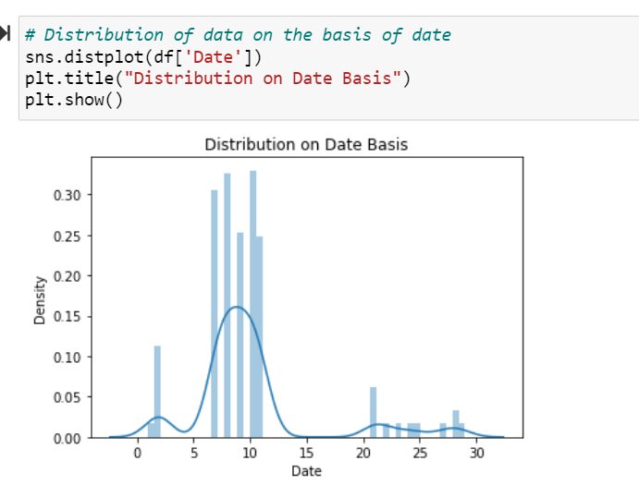
Most of the data available are either from starting dates or month end dates, We don't have data from middle of the month.

Slide 12
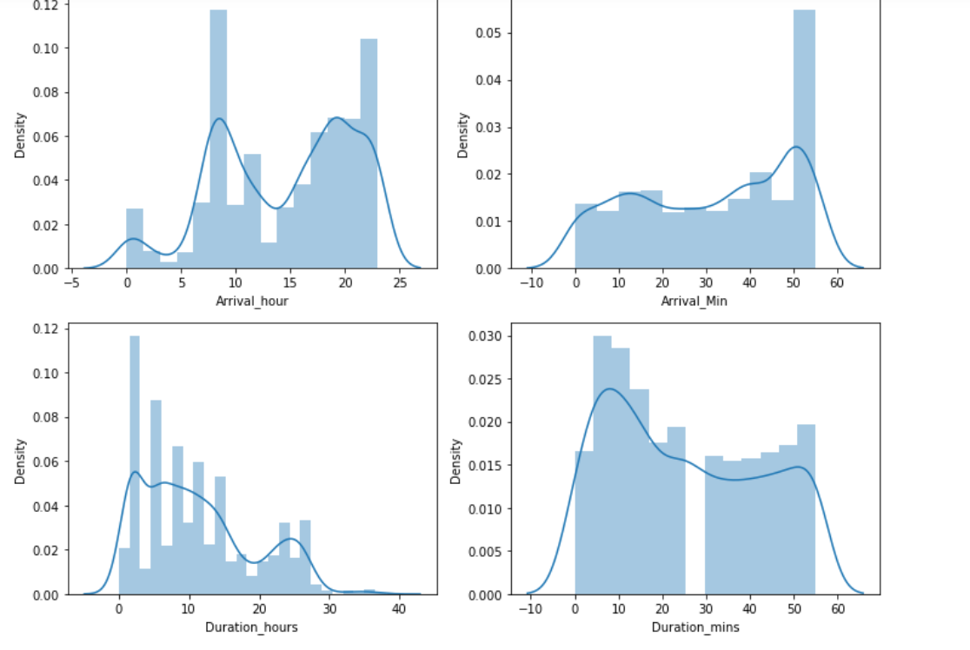
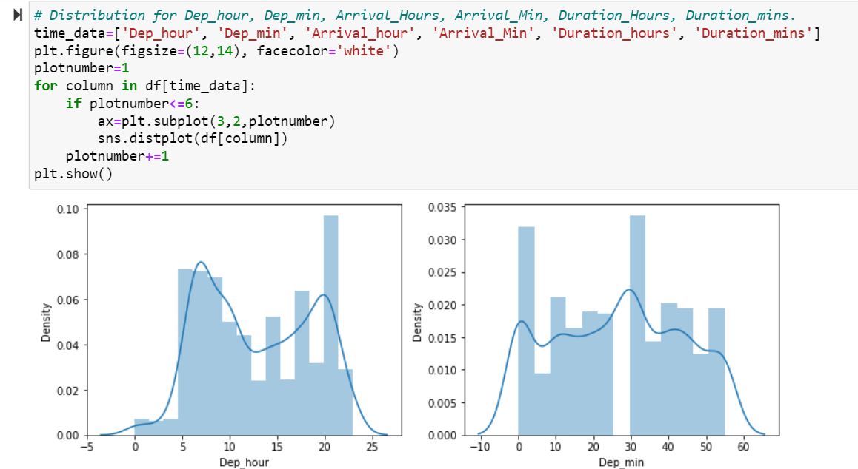
We can observe that our departure time data, which we feature engineer to make Dep_hour and Dep_min is discrete in nature, we can clearly see the distribution in the above plot.
Also, We can observe the data distribution on the basis of arrival time and total duration. The hours here are in 24 hrs presentation while mins are represented in 60 mins form. And we can see that data is distributed accordingly. And our now features are discrete in nature.

Slide 13
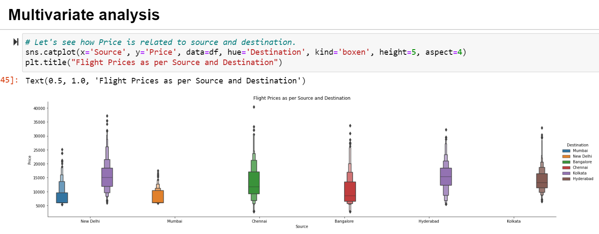
We can observe that the average price for Kolkata flights are highers. while Delhi-Mumbai flights are comparatively cheap.

Slide 14
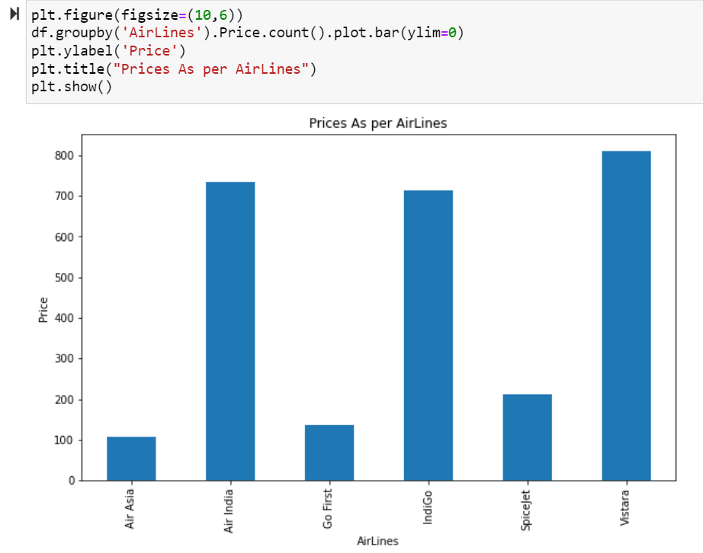
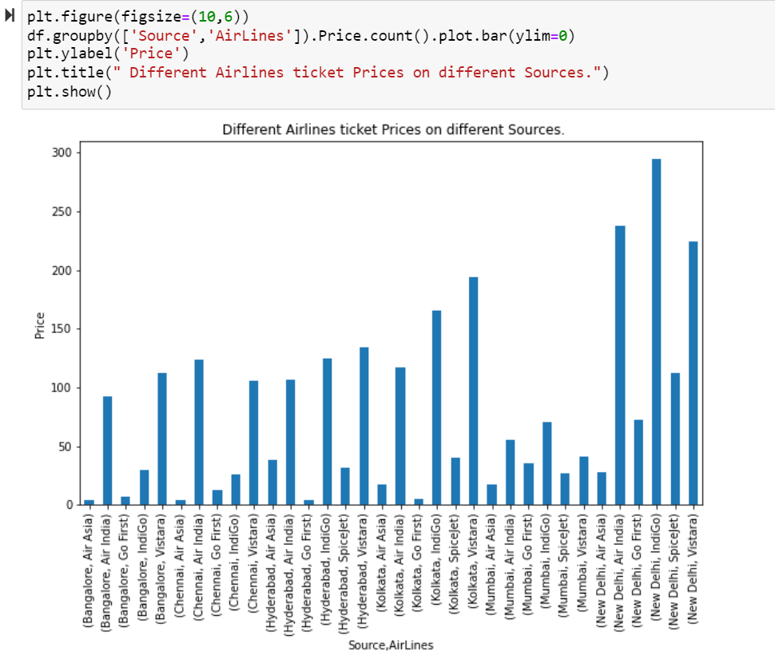
We can see that the Flight ticket Prices for Vistara airlines are higher as compared to others. While Air Asia seems to be the most economical AirLines among the remaining.
We can observe that New Delhi, Indigo has the highest Price Point while Chennai, AirAsia and Banglore AirAsia has lowest Price point. Also we can observe that economical flight tickets are availabe for Air Asia, Go first while Indigo, Vistara, Air India are comparatively costlier.

Slide 15
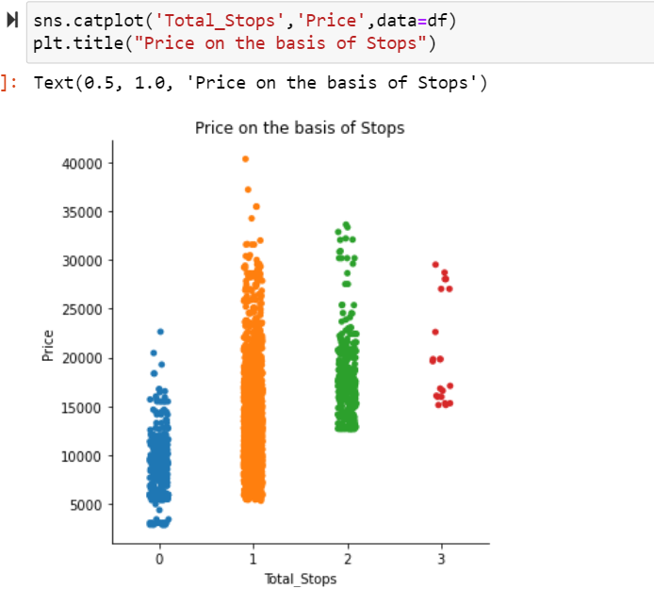
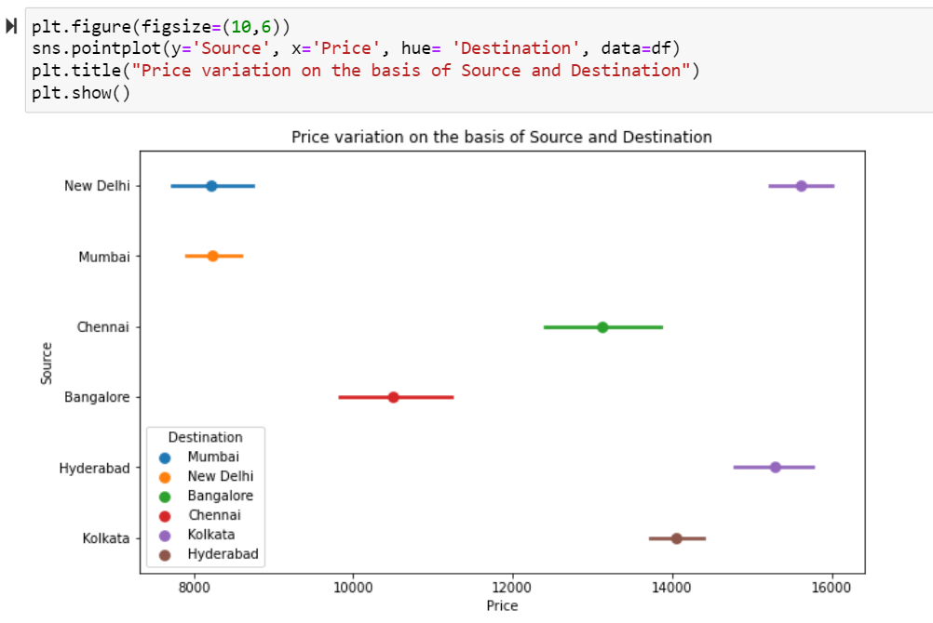
We can Observe that direct flights are compoaratively cheaper than 1 stop or more stops flights. If the highest price for Non stop flight is around 23000, than we can say the hightest price for stop flight is around 36-37K.
We can see that comparatively Delhi to kolkatta, Hyderabad-Kolkatta flights are more expensive in general. While Mumbai delhi, Delhi Mumbai flights are comparatively cheaper. In this plot, the x axis denotes the price, while y axis denotes Source, And colorful points in the plot denotes the destination source and price relationship.

Slide 16
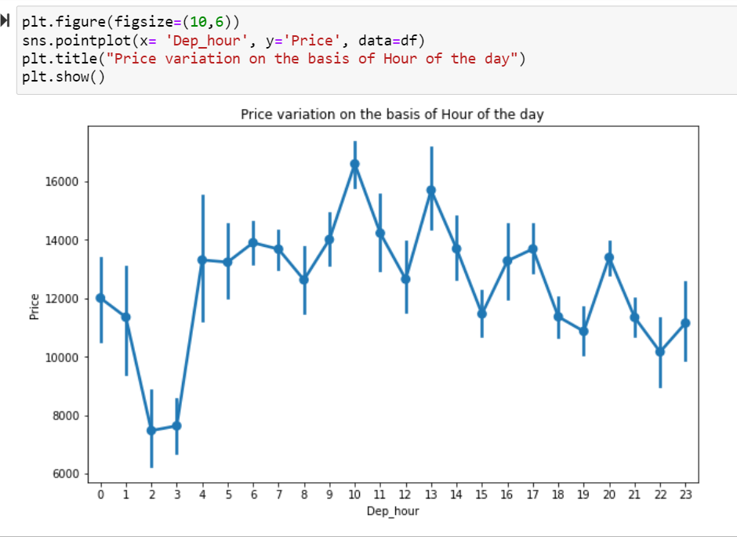
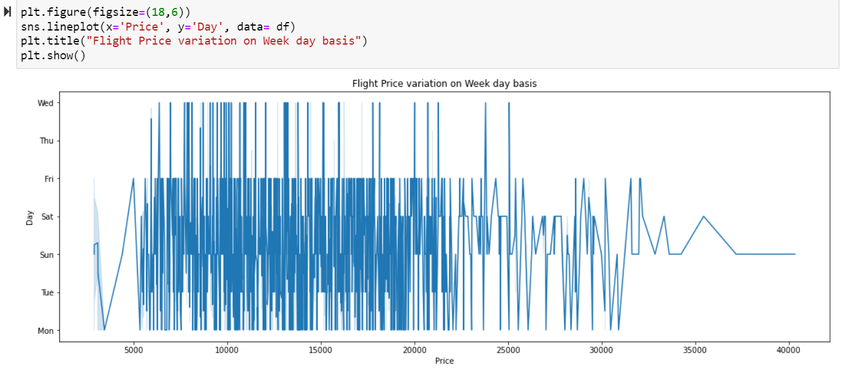
Although the weeks are not properly line up, we can clearly see that Sunday's are expensive. We also observe that Friday, Saturday, Sunday and Monday are the days we have expensive tickets, while Tuesday, Wednesday, Thrusday are comparatively cheaper tickets.
On the basis of this we can observe that the Flight Price varies with the hour of the day, generally Morning flights are expensive compared to late nights or midnight flights.

Slide 17
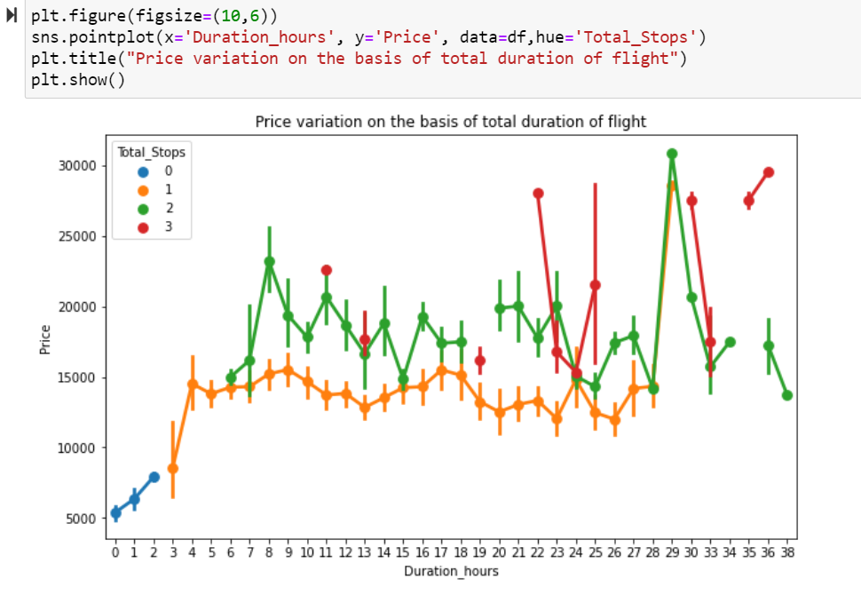
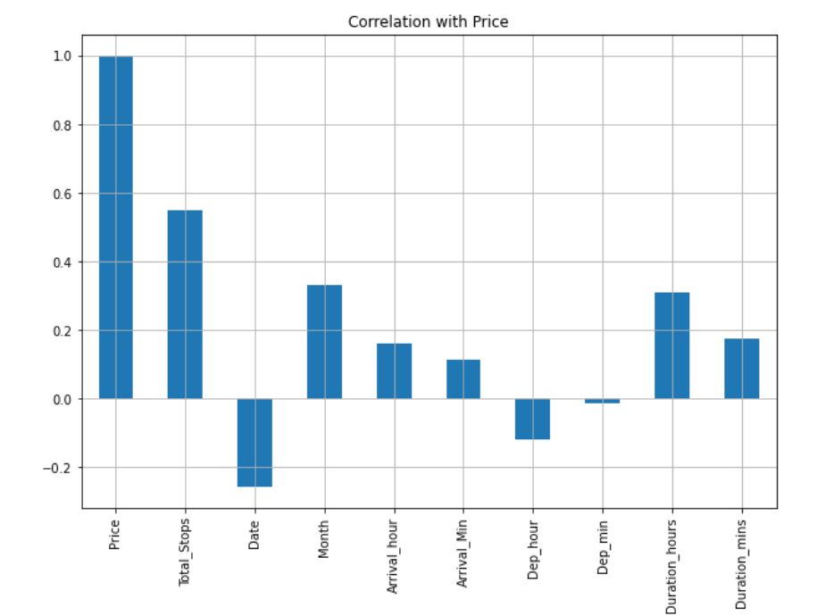
From above observation we can say that Longer duration flights charge more money, i.e., the Flight ticket Prices are increases. We also observe that the flights with more number of stops also cost more, if its longer duration flights.
From correlation with price plot we can observe that Date, Dep_hour and Depmin are inversely related to the flight Price.While Total_stops, Month, Arrival_hour, arrival_Min, Duration_Hours and Duration mins are positively correlated with flight Price. Inverse correlation means when value of one increases the value for other decreases and vice versa. While positive correlation means if one increases the other is also increases.Here we can see, that Price of Flight Ticket is highly correlated with Total Stops, while least correlated with Dep_min.

Slide 18
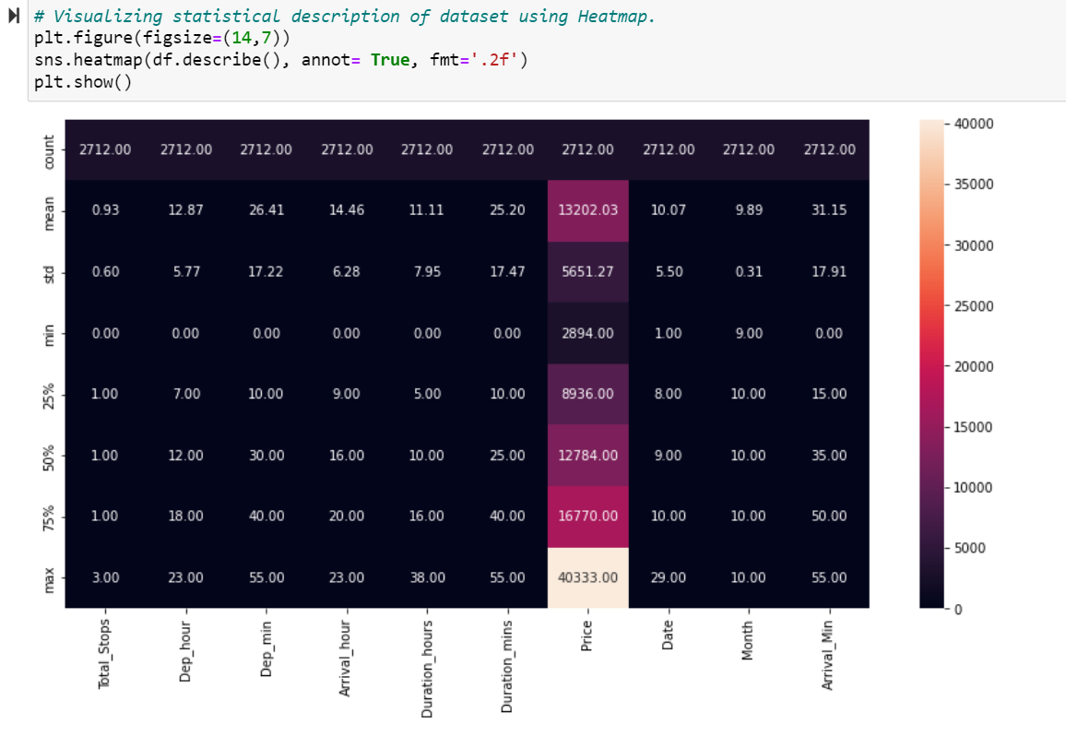
Statistical Description visualization
From above statistical description of data we can observe that, Price is our label or target variable. We have 2712 rows of data for all the features present in the dataset. Our dataset looks decent, with highest number of 3 total stops, all hourly details are in 23:00 terms and minutely details have max of 55 seems logical. In my opinion we can move ahead with this dataset.

Slide 19
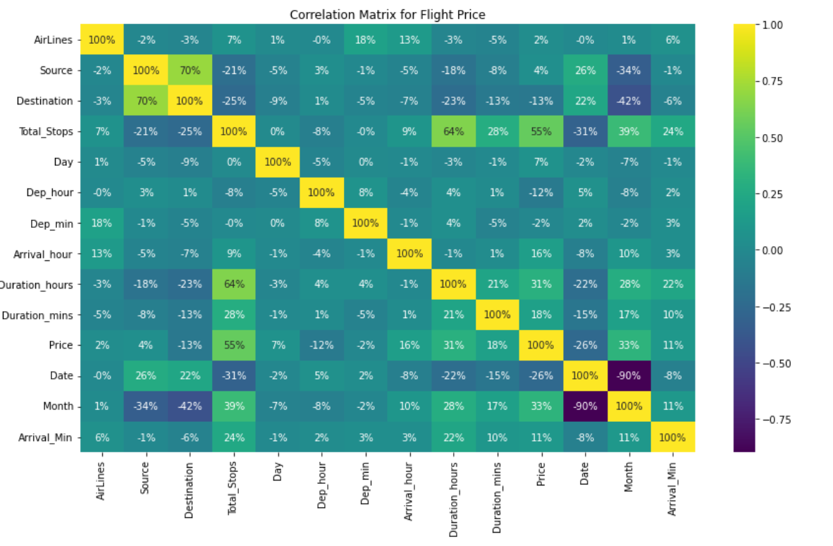
Correlation Matrix
From here we can observe that Total Stops is highly correlated with our label, Price. We can also see the relation among various independent features. This correlation matrix consist of all the features of dataset as well as label.

Slide 20

Regression model building: After data cleaning, EDA, data preprocessing which definitely include scaling. We also check for skewness and outliers. When everything looks good, we finally proceed to final model building approach. For that we split our data into training and testing dataset.
This is the basic approach which every ML model building starts with, then we use these dataset to train our model/ using different algorithm. Starting from linear model, then ensemble technique, regularization technique, boosting technique, other advance techniques.
The Evaluation parameter here in our model will be r2 score, MAE and RMSE.
We decides to r2 score as our primary evaluation metrics while Mae and RMSE as our seconadary evaluation metrics.
In our Project, we build : Linear Regression Model, Randomforest Regressor Model, Lasso Model, AdaBoost regressor Model, and Finally XGBoost regressor Model.

Slide 21
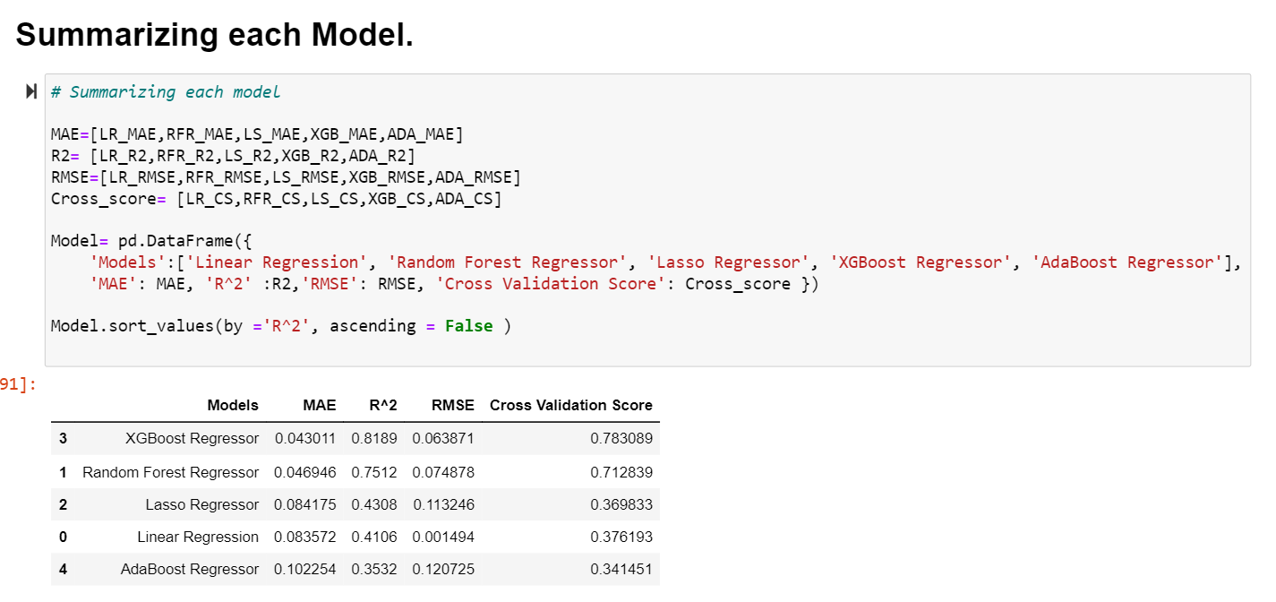
Summarizing Each Model.

Slide 22
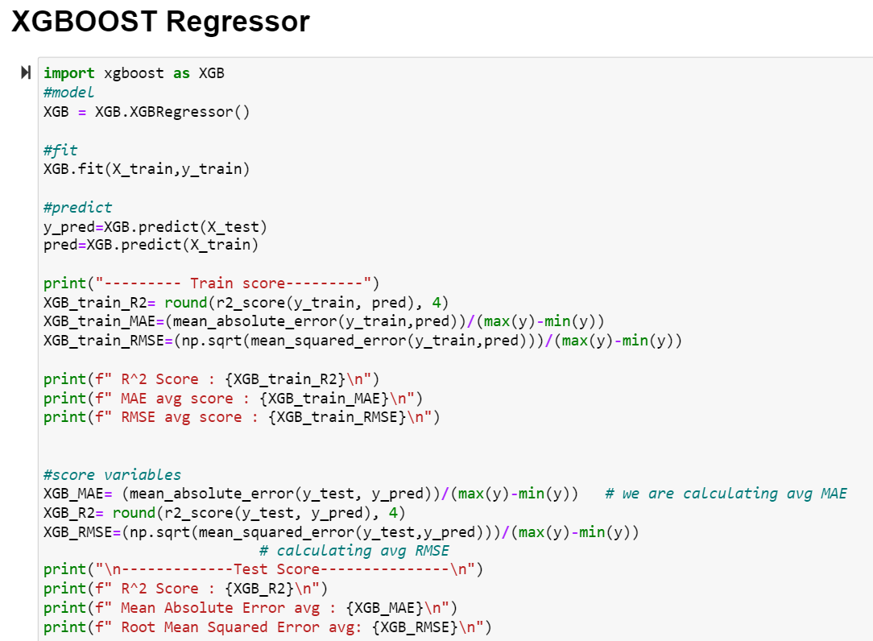
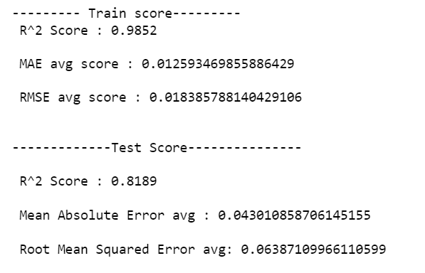
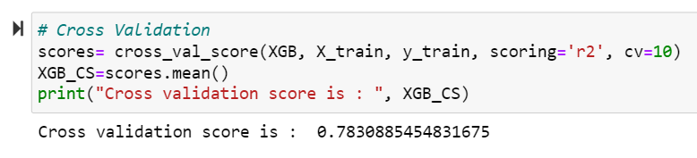
From the Summary it is clear that XGBoost Regressor is our final model, as it has highest r2 score as well as minimum value for mean absolute error & root mean squared error. Let’s see how we Build XGBOOST Regressor Model.

Slide 23
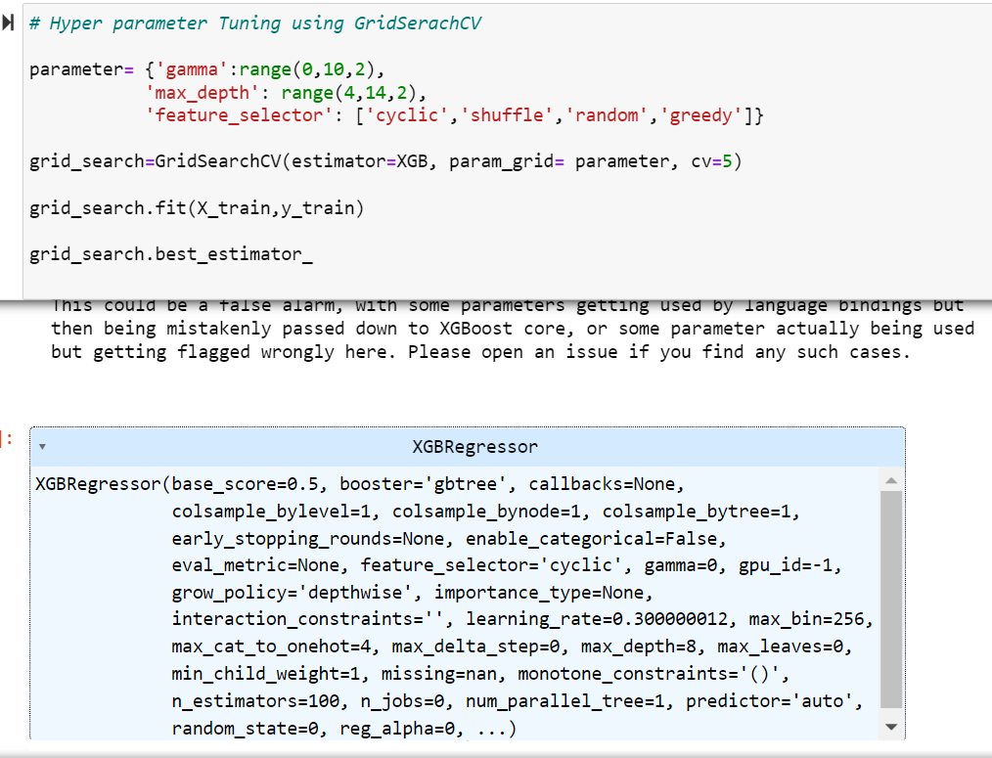
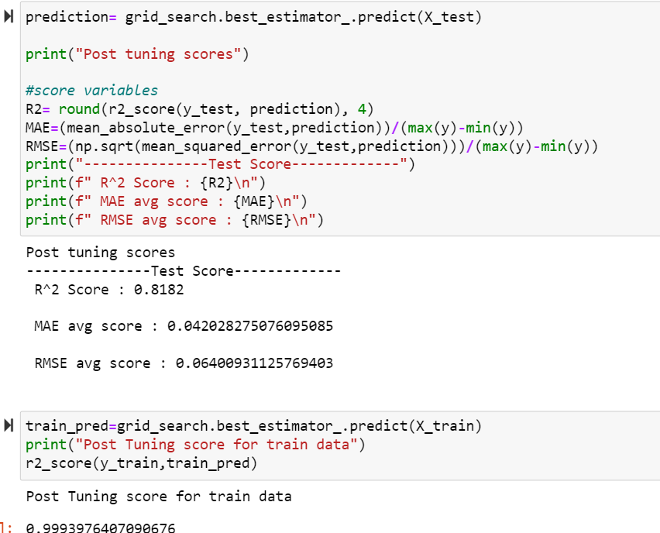
After cross validation scope, we did perform Hyper parameter tuning, in order to improve the efficiency of the model. For that we use RandomizedSearchCV method, as it is fastest.

Slide 24
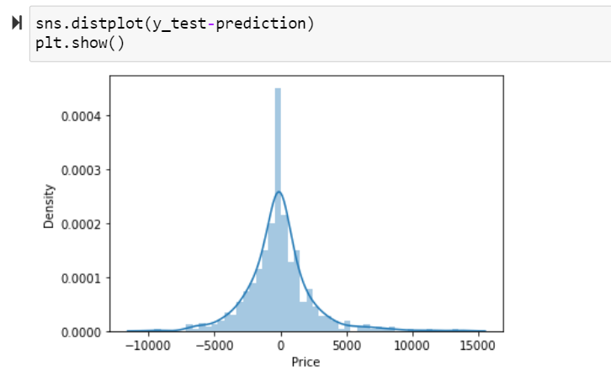
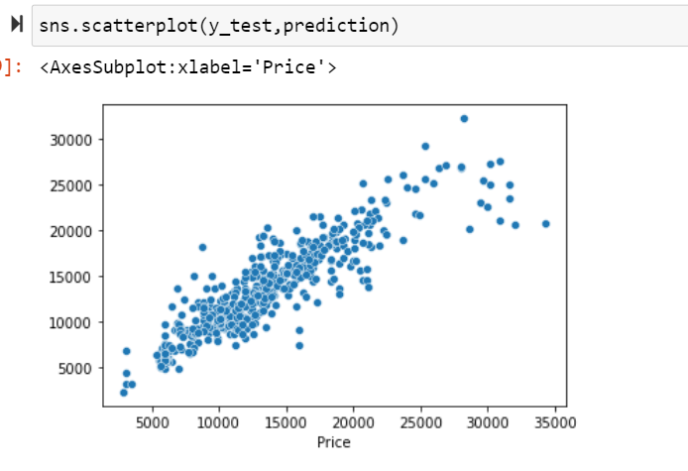
We can observe that both predicted value and actual value lies almost in the same line. This visualization helps us to visualise how our predicted value and actual value fall in the same line with same deviation.

Slide 25

Conclusion
Price shows highest correlation with total Stops, we also observe that Day and Departure Time also plays a significant role as the deciding factor for Flight Price.
We also see Airlines, is also one of the important feature which shows strong correlation with Price.
We also observe that, as per the dataset we collect Ensemble technique and advanced boosting techniques handle our model effectively, as compared to linear model or regularization model.
Also, Source and Destination Feature is the key for determining the flight ticket prices.
About date and month, as we don’t have sufficient information for through out the year, what little we have we can say that tickets price varies with respect to the duration when you are booking the ticket and when you actual travel.
XGBoost regressor is the best suitable model, which we finally save using pickle method.

Slide 26
Thank you

